Slide 1
Customer Satisfaction using Market Basket Analysis
Faculty Mentor
Dr Hitesh Kumar Sharma
Members
Utkarsh Sandeep Singh
Tushar Singh
Adesh Kumar Gupta
Shankey Gupta

Slide 2
Problem Statement
Nowadays people buy daily goods from super market and marts. The problem which many retailers face is the arrangement of items in their store. They don’t know what item should be put at what place in their store so that all the associated products are available nearby.

Slide 3
Description
In today’s generation many marts and wholesalers are competing with each other to provide more and more satisfaction to their customers. As the needs of the customers are being fulfilled by the retailers and managers with less efforts, it creates a chance of shopping more different products by the customer.
To understand how to analyze this pattern we will be implementing a Data Mining technique called MARKET BASKET ANALYSIS with the help of Apriori Algorithm.
Through this technique we are able to understand how the products are arranged in a mall , store, or a shopping complex such that less efforts of the customer will result them in purchasing most of the products of their needs even if they didn’t planned to buy it.

Slide 4
Objectives
To identify the frequent items from the transaction on the basis of support & confidence.
To generate the association rule from the frequent item sets.

Slide 5
Methodology
Theory:
Market Basket Analysis is a technique which works on the principle that if a customer
buys a product, he is more likely to buy some more specific set of products along with it.
For the implementation of this technique, we need to have some sort of requirements:
1- DATASET
2- ALGORITHM:
Apriori Algorithm

Slide 6
Apriori Algorithm
By applying Apriori Algorithm onto a dataset, we will be having 2 factors:
1- Support:
A support is a parameter which is used in Apriori Algorithm to determine how frequent the item appears in dataset.
2- Confidence:
Confidence indicates the number of times the if/then statements have been found to be true.

Slide 7
Mathematical Model:
• Calculate Support/frequency of individual item from total set of items
• Reject those items, whose support<2
• Combine it further into duplets
• Calculate support/frequency
• Reject those group of items, whose support<2
• Do it again by combining it to triplets, quadruplets and so on.....
• Again, reject those group of items, whose support<2
• At the last, we will get those set of items, which are having high support or which is
bought more frequently.
• To calculate Confidence,
Confidence=Support of Combined Products / Support of Prescribed Product

Slide 8
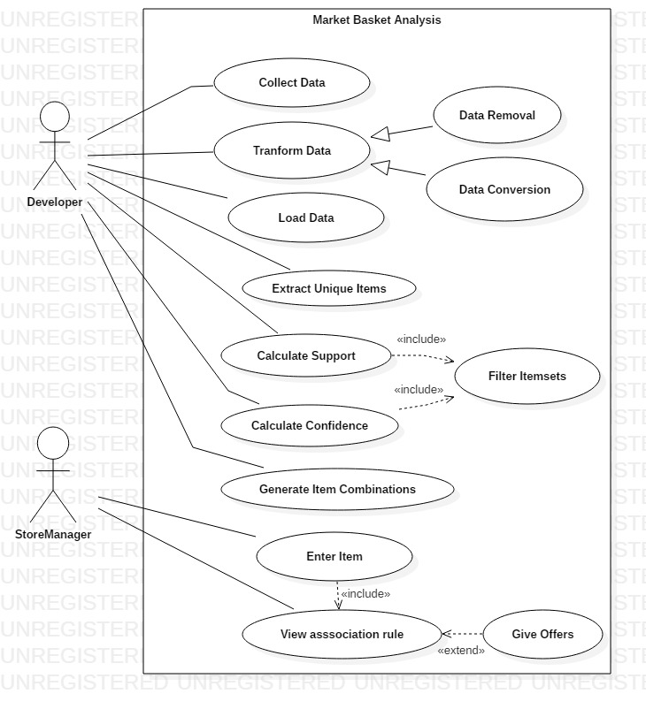
Use Case Diagram

Slide 9
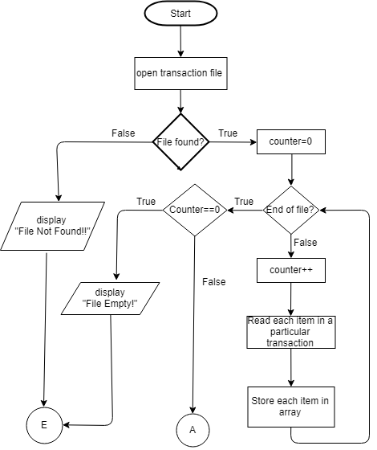
Flowchart

Slide 11
Algorithm
Start
Read Transactional Data
Store unique items
Input minimum support and minimum confidence
Calculate support for itemsets
Remove itemsets whose support < minimum support
Calculate confidence of remaining itemsets.
Remove itemsets whose confidence < minimum confidence
Add remaining itemsets to association rule.
10. Make combination of itemsets.
11. Repeat from step 5 to step 11 until all possible combinations of items are formed.

Slide 12
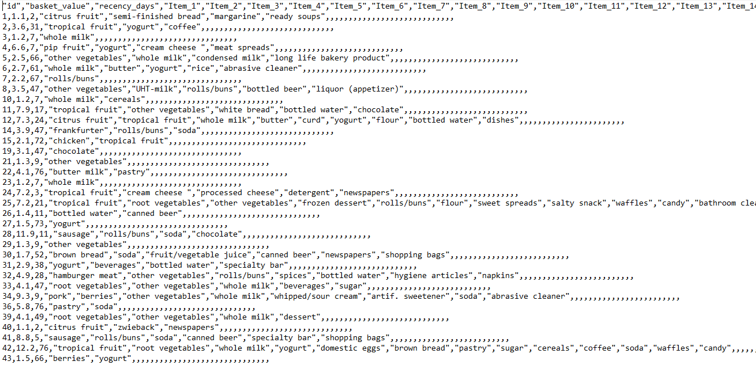
Progress
Raw Data

Slide 13
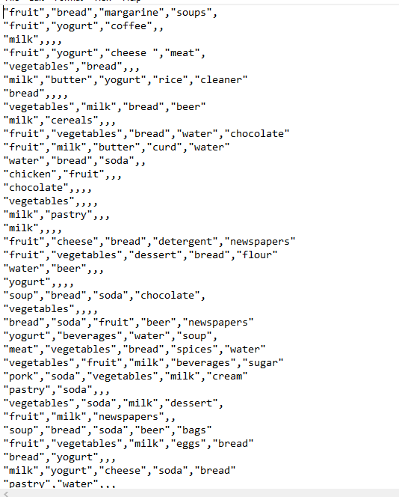
Cleaned Data

Slide 14
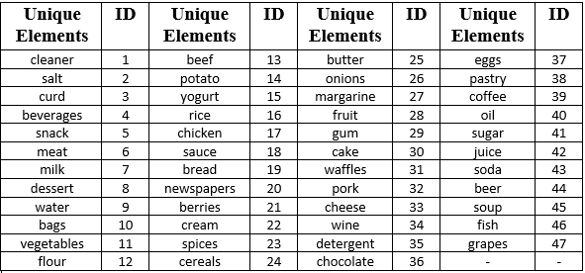
From the cleaned data we get the following unique elements

Slide 15
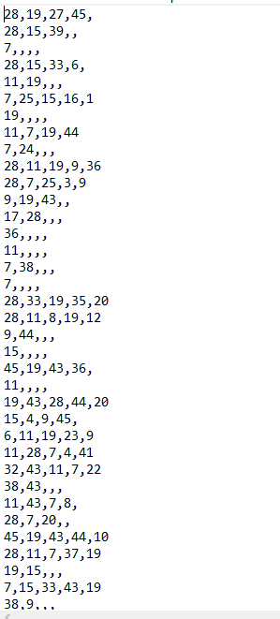
Transformed Data

Slide 16
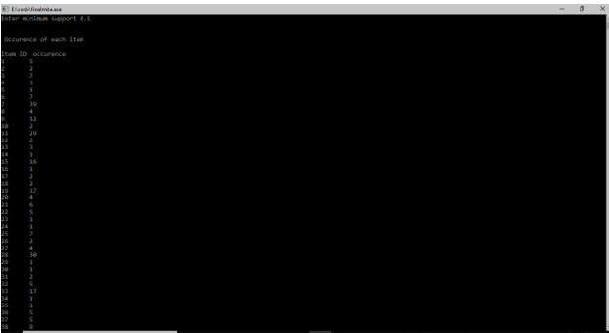
Output Screen

Slide 17
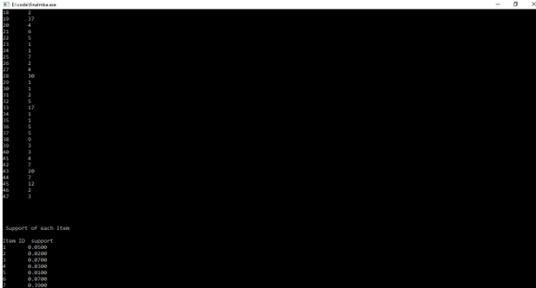

Slide 18
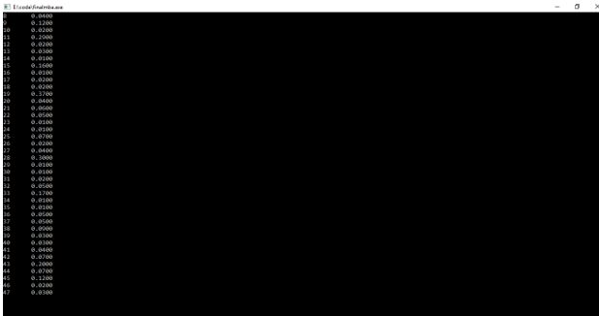

Slide 19
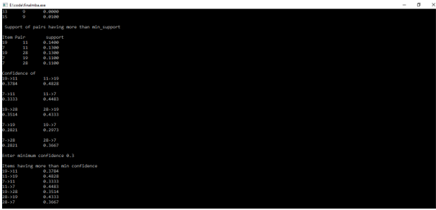

Slide 20
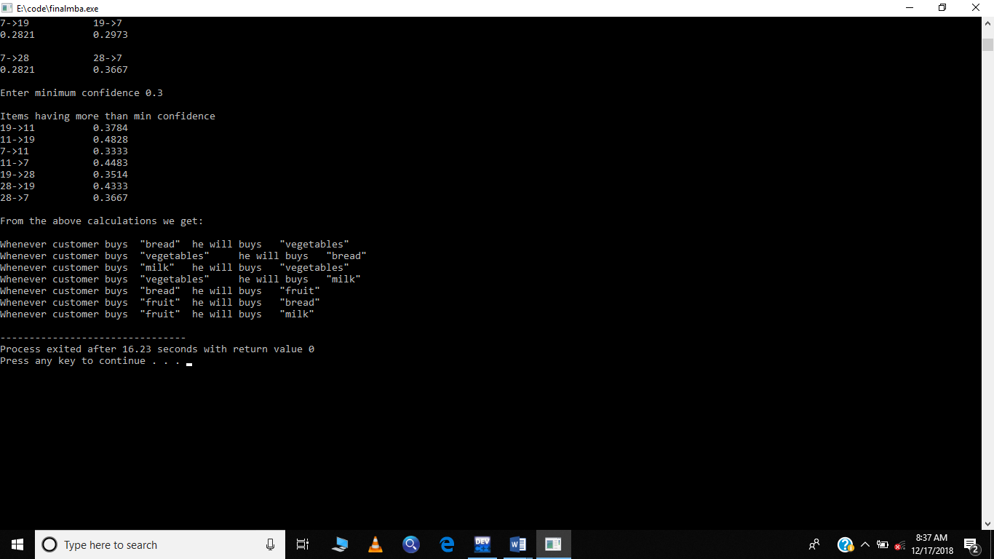
Result

Slide 21
Schedule(Pert Chart)

Slide 22
THANK YOU!

